Slide 1
LESSON 7.2
Electrolytic Cells

Slide 2
LESSON GOALS
I can identify electrodes as anode and cathode, and identify their signs/polarities in electrolytic cells, based on the type of reaction occurring at the electrode
I can explain how current is conducted in an electrolytic cell
I can deduce the products of the electrolysis of a molten salt and aqueous solutions of a salt
I can deduce equations for the electrode reactions during electroplating

Slide 3
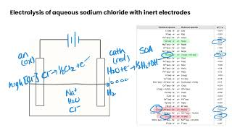
TASK 1: LEARN (MUST DO)
Individually or with a partner:
Watch the Electrolytic Cells video
Take some notes for yourself!

Slide 4
TASK 2: PRACTICE
Complete the electrolytic cells practice (answers included)
Note: There are must do and should do questions included in this practice!

Slide 5
TASK 3: MASTERY CHECK (MUST DO)
Individually:
Complete the Electrolytic Cells Mastery Check (see me when you are ready!)

